Slide 1
illbruck Projecting Window System (PWS)
New 2014: PR010 window mounting angle,
PR011 window mounting panel, PR012 insulating block
Simon Pronath, Product Management CEU

Slide 2
PR010 window mounting angle

Slide 3
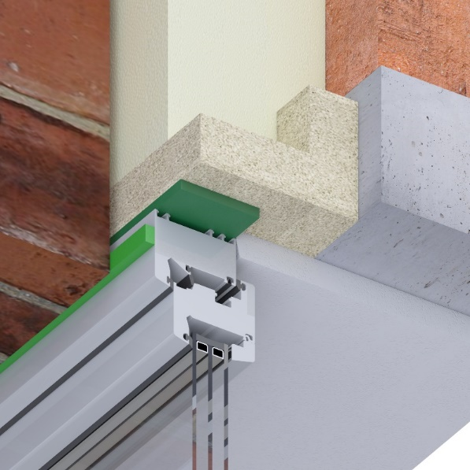
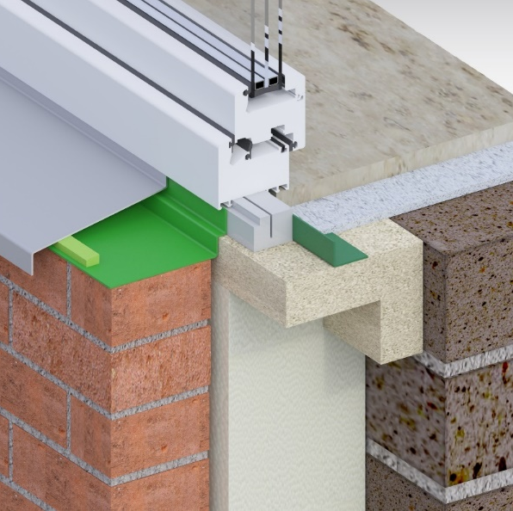
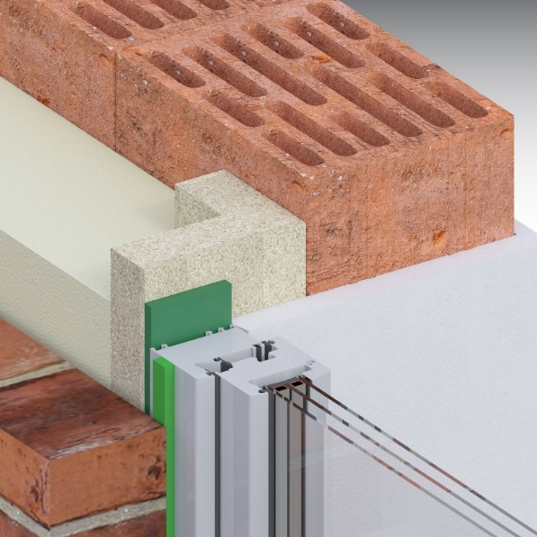
PR010 L-shape angle
    ift component test
    from 50 mm plate
    projection 120 / 140 / 160 / 180 / 200 mm
    120 mm high
    length: 1400 mm
    weight: 5,8 – 7,5 kg/m
    manufactured to order
    delivery time 8 days
    PR012 insulating block
      possible

Slide 4
illbruck projecting window system
flexibility
tasks:
projection 35, 90, 120, 140, 160, 180, 200 mm
large packets
order-related quantities
equipment edit
4

Slide 5
illbruck projecting window system
New PR010 angle 120 mm
PR010 L-angle 120 mm
PR012 insulating block
PR010 L-angle 140 mm
PR012 insulating block
PR010 L-angle 160 mm
PR012 insulating block
PR010 L-angle 180 mm
PR012 insulating block
PR010 L-angle 200 mm
PR012 insulating block
PR011 panel 35er
PR007 frame 90 mm
PR008 insulation wedge
5

Slide 6
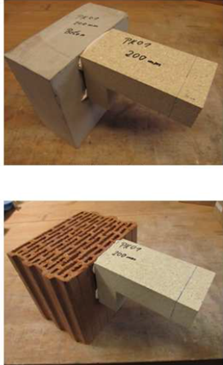
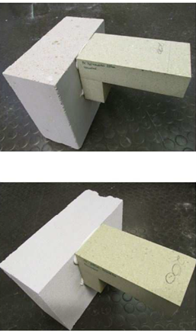
PR010 angle load capacity
presentation
presentation
bonded to concrete
bonded to limestone
bonded to bricks
bonded to aerated concrete

Slide 7
PR007 frame and PR010 angle
load capacity
The load figures shown were obtained with an assumed min. 7-fold safety and reduction of the long-term stress according to the ift VE-08 determined. The loads were extrapolated from 10 cm to 100 cm widths experimental angles.
refers to 1 meter frame
with 7-fold safety
with 3-fold safety for artificial aging
for not requiring authorization systems
breaking load is about 10-fold higher

Slide 8
PR007 frame and PR010 angle
load capacity - example
window 1.30 x 1.70 m with 3-fold glass on calcareous sandstone with 160 projection
calculate weight of the window, page 104 + 112 in the LZM = 90 kg
set substrate = limestone
set type and projection = 160 mm
see table = 149 kg/m
static calculation: 149kg/m x 1,30 m = 193,7 kg load transfer only below!
Static is sufficently dimensioned, like this example 90 kg < 193,7 kg

Slide 9
PR011 window mounting panel 35 mm

Slide 10
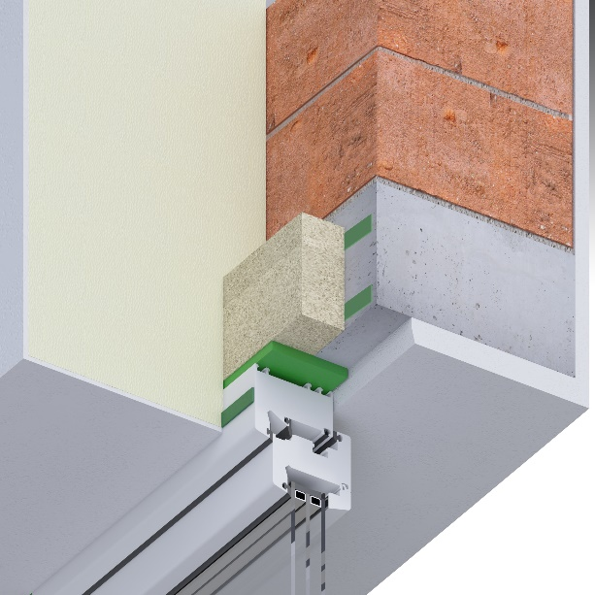
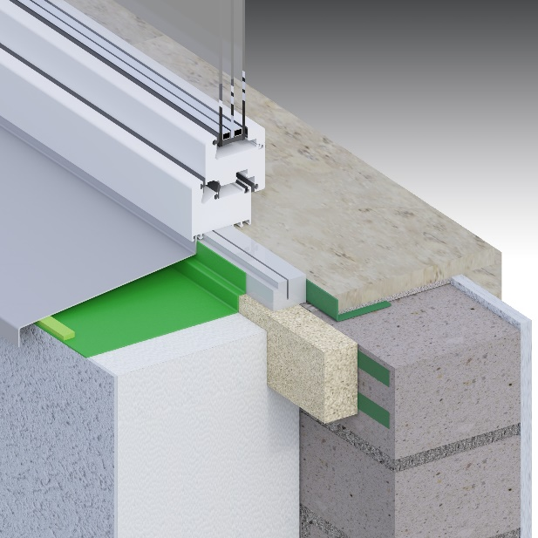
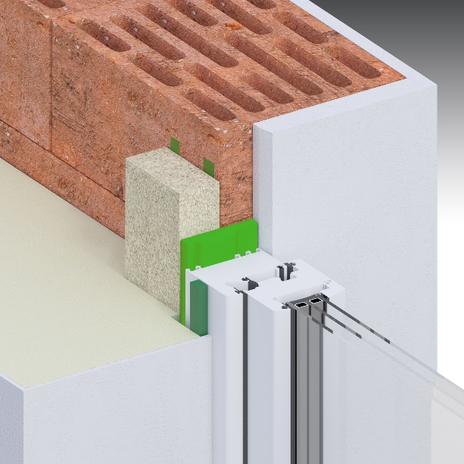
PR011 panel 35 mm
    ift component testing
    from 35 mm plate
    35 mm projection
    90 mm high
    Length: 1400 mm
    Weight: 1,8 kg/m (PR007 2,7 kg/m)
    manufactured to order
    delivery time 8 days

Slide 11
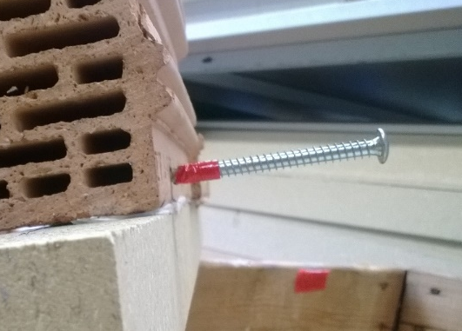
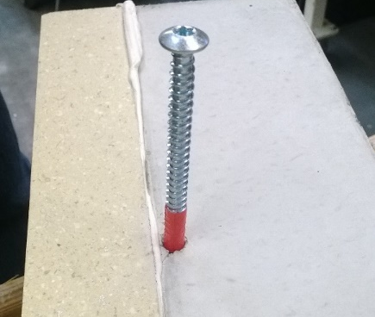
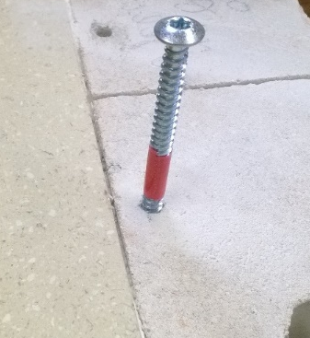
PR011 panel 35 mm
benefit edge distance
Choose edge distance independet of the masonry
Annulment the manufacturer's specifications by a "security" with Purenit strip
Hochlochziegel, MW-Abstand ca. 10 cm
Beton, MW-Abstand < 5 mm
KSV, Abstand MW ca. 10 mm

Slide 12
sound insulation

Slide 13
illbruck projecting window system
sound insulation
Question: what is the difference of sound insulation in various installation situations?

Slide 14
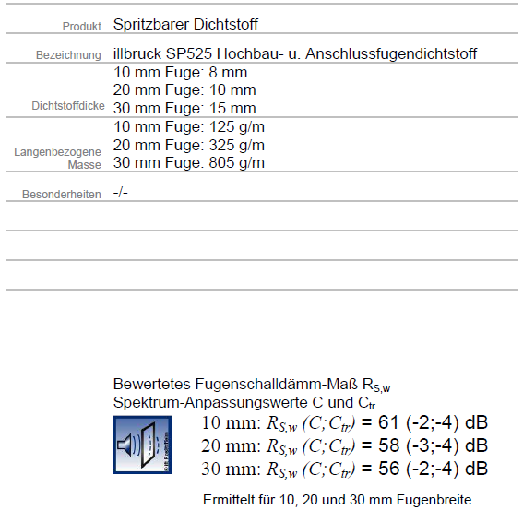
illbruck projecting window system
sound insulation
What we know:

Slide 15
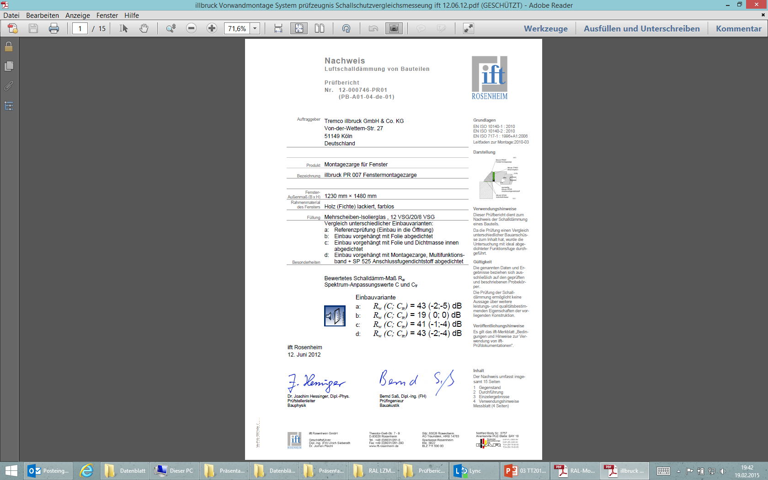
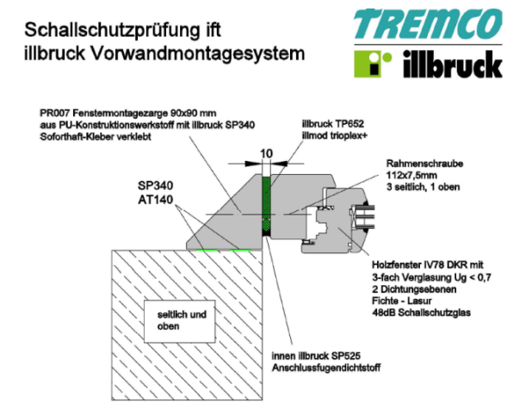
illbruck projecting window system
sound insulation
What we‘ve tested:

Slide 16
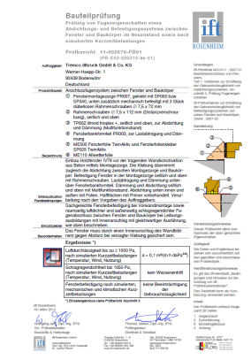

illbruck projecting window system
sound insulation
PR011 and PR007
ift-testing for illbruck projecting window system
soundproof window with 43 ​​dB (without sound side paths!)
combination window 43 dB + PWS + TP652 + SP525 inside = 43 dB.
does not reduce the rated sound insulation value of the window (this is the value that sound-proof windows without sound side paths reaches maximum)
16

Slide 17
illbruck projecting window system sound insulation
PR010 window mounting angle

Slide 18
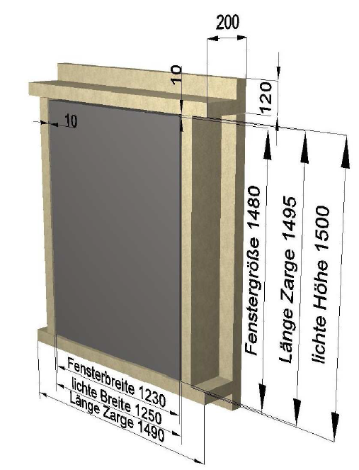
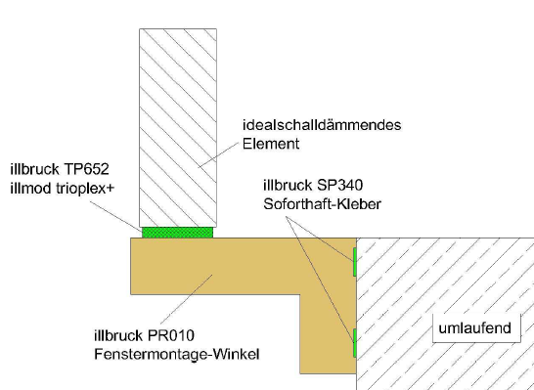
illbruck projecting window system sound insulation
PR010 window mounting angle
PR010 window mounting angle

Slide 19
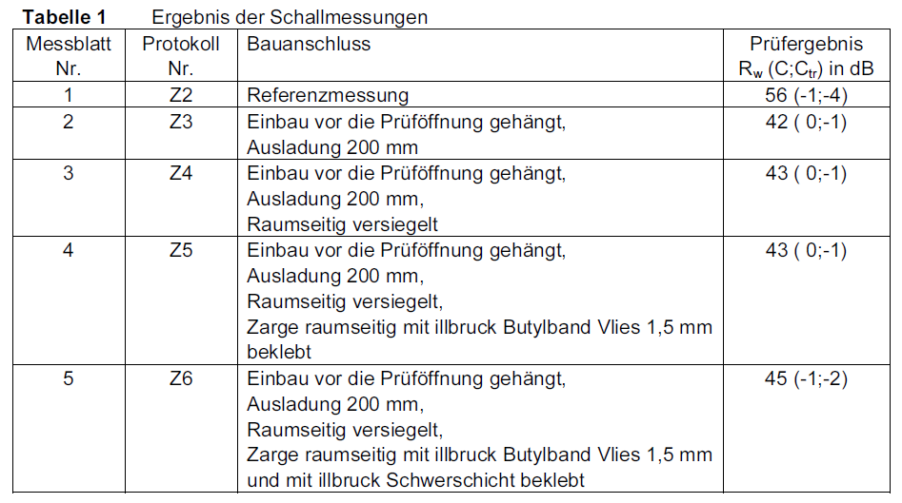
illbruck projecting window system sound insulation
PR010 window mounting angle result

Slide 20
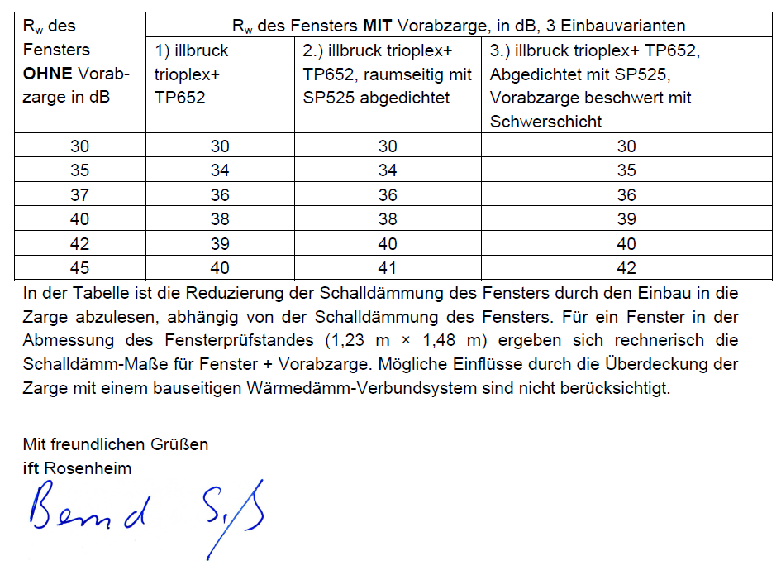
illbruck projecting window system sound insulation
PR010 window mounting angle
developed conversion table

Slide 21
New from June 2014
Summary

Slide 22
illbruck projecting window system
PR010 angle in 120 mm projection (120 to 200 mm
new processing movies on the internet
    https://www.youtube.com/watch?v=P9N-E5_qdNU
    https://www.youtube.com/watch?v=e43vUq2nS5o
    https://www.youtube.com/watch?v=10sZqxjJn7A
new load transmission table in the data sheet
All types make to order → short delivery times
new brochures 20 pages
PWS price list with consumption calculator (SU Germany)
Hand sample for PR011, PR007, PR010 angle and panel at the post office
22

Slide 23
Burglar Inhibition
according to RC2 und RC3 (old WK2 and WK3)
DIN EN 1627-1630

Slide 24
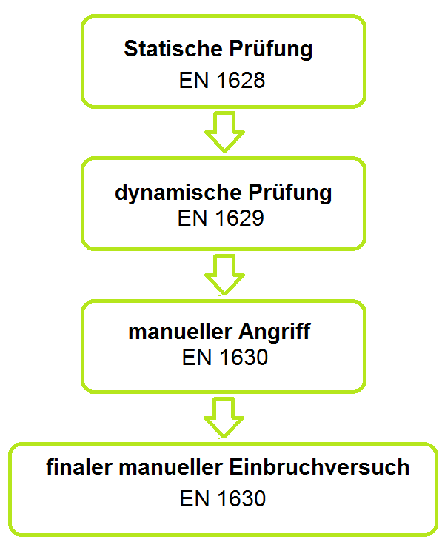
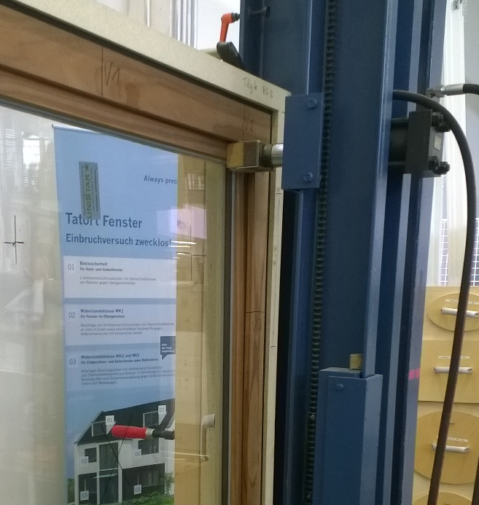
Basics RC3
an genau definierten Punkten wird eine Kraft (mit Hydraulikzylinder) kontinuierlich aufgebaut. RC3 = 6.000 N (6 kN)
Pendelschlagversuch von außen(!) 50 kg. RC 3 = 750 mm Fallhöhe
Angriffszeit 5 Minuten Werkzeug: Schraubendreher, Kuhfuß
Notes:
← bestanden, wenn sich keine Spaltlehre in eine Öffnung schieben lässt (das ist ein Rundstahl mit 10 mm Durchmesser und 200 mm Länge mit Griff

Slide 25
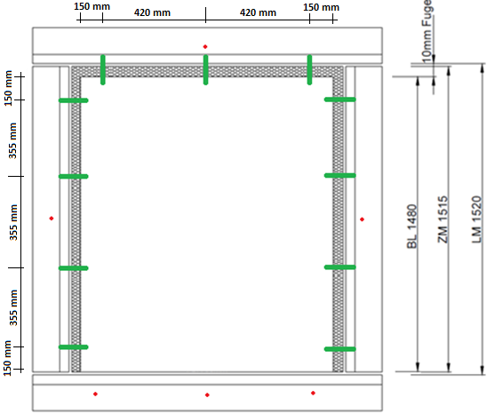
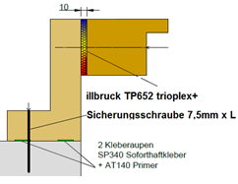
Mock-up RC3
PR010 Fenstermontage-Winkel 200 mm projection
    Ø 7,5 mm Sicherungsschrauben: below 3, side/top á 1 = 6 Stück
IV 68 timberframe RC3; size: 1,23m x 1,48 m
    Ø 7,5 mm Rahmenschraube: side á 4, top 3 = 11 Stück
TP652 trioplex+ 66/7-15
Notes:
Abdichtung/Befestigung unten:
Fenster „knirsch“ in eine Raupe SP340 auf PR010 gesetzt

Slide 26
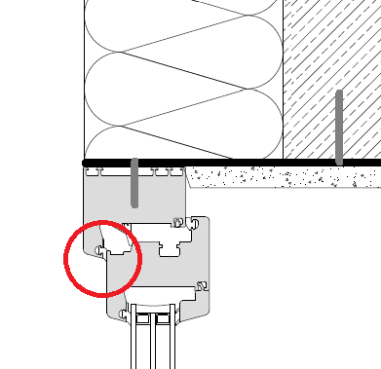
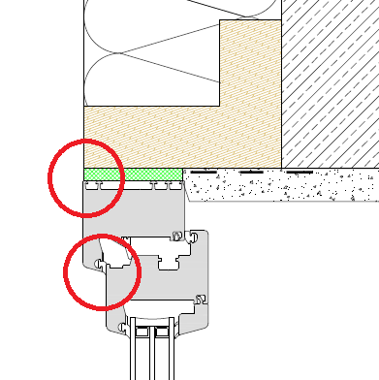
illbruck projecting window system
RC2 und RC3 System-Testing
Special feature of our test:
manual attack usually only between frame and window:
We also between the frame and angle:
Simulates the attack during the construction phase in the “not yet covered” state.
Both is possible with PWS!

Slide 27
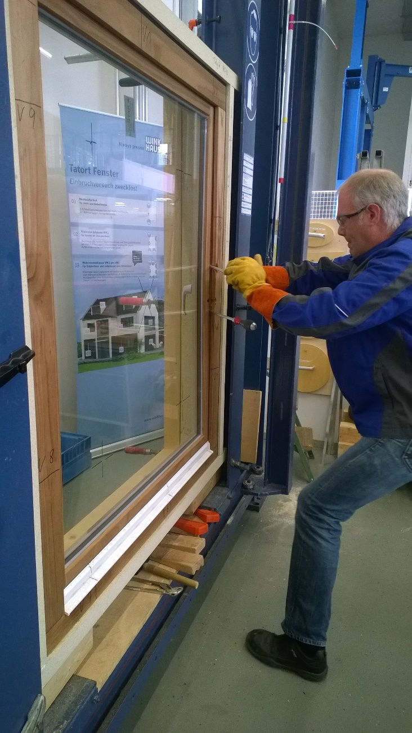
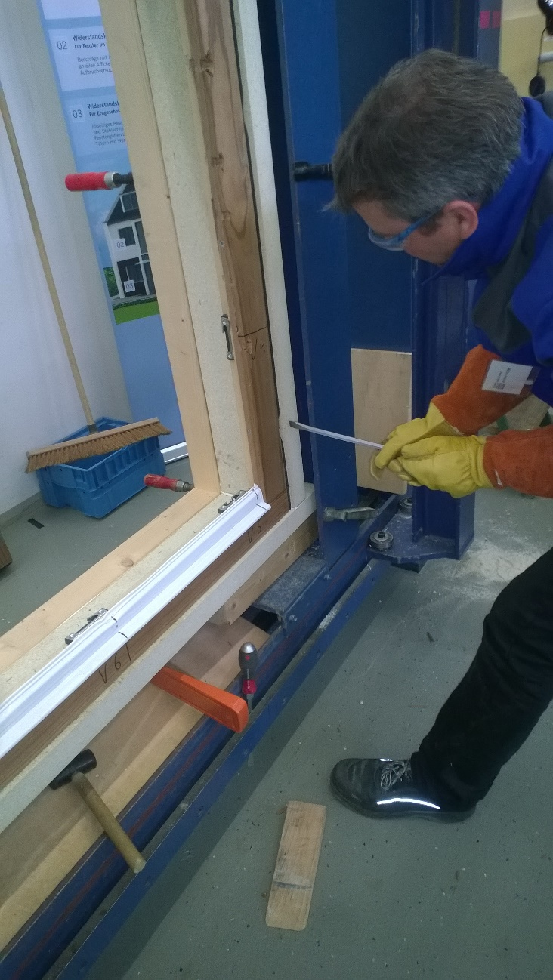
illbruck projecting window system
RC2 und RC3 System-Testing
Manual attack frame-winow manual attack frame-PR010

Slide 28
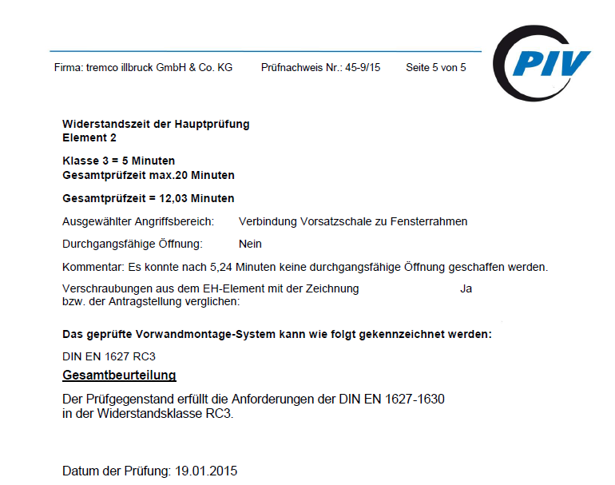
Result RC3
Notes:
Das PIV in Velbert ist ein renommiertes und akkreditiertes Prüfinstitut für Beschlags-Technik.
Vorprüfung war bei WINK HAUS in Telgte.
Wir können sagen, dass wenn das Fenster selbst RC3 hat, es auch in unserem Vorwandmontage-System Typ 3 (120-200mm Ausladung) verbaut werden kann.
Typ 1 + 2 müssen erst noch (evtl. gutachterlich) überprüft werden.

Slide 29
Thank You!
Simon Pronath
Product Management Central Europe
tremco illbruck GmbH & Co. KG
Von-der-Wettern-Str. 27
51149 Köln
T: +49 2203 57550-227
frank.woermann@tremco-illbruck.com
Info.de@tremco-illbruck.de
www.tremco-illbruck.de

